Slide 1
REST API / RESTFul Web Service
AMOL R PATIL PUNE - 9822291613

Slide 2
Web Service
From Wikipedia
A web service (WS) is either:
a service offered by an electronic device to another electronic device, communicating with each other via the Internet, or
a server running on a computer device, listening for requests at a particular port over a network, serving web documents (HTML, JSON, XML, images)

Slide 3
Web Service
It is a client-server application or application component for communication.
The method of communication between two devices over the network.
It is a software system for the interoperable machine to machine communication.
It is a collection of standards or protocols for exchanging information between two devices or application.

Slide 4
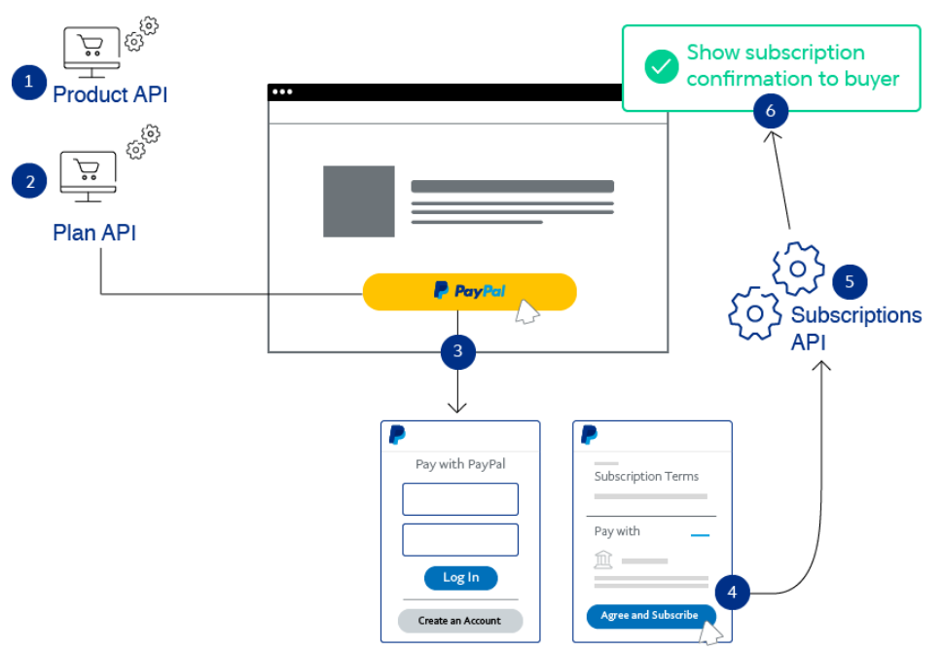
Web Services Use Cases – Payment Gateway
Paypal, a popular online payment provider, which supports gateway integration and actively uses web services to help its clients securely conduct mobile and online payments.
Paypal REST API serves for transaction workflows like payments, orders, invoicing, subscriptions etc., using the HTTPS channel and JSON responses.

Slide 5
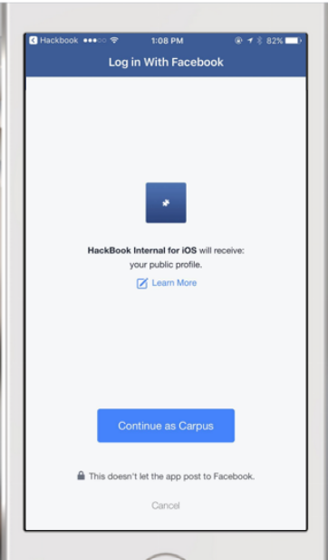
Web Services Use Cases – Social Plugins
Today it’s common to log-in using social media account credentials. For instance, if you want to quickly register on a new website. It’s possible to go the traditional way and enter all the necessary personal information. Since it might be quite time-consuming, that’s where the social plugin option becomes truly convenient.
Its working principle is simple. Each time someone launches the app, it uses a web service to verify if this user was already logged in via a social platform. If that’s not the case, after the “Log-in Using XYZ” button is pressed, a pop-up window requests to confirm this person wants to proceed with the social plugin. After the confirmation, the API sends the identification information back to the app.

Slide 6
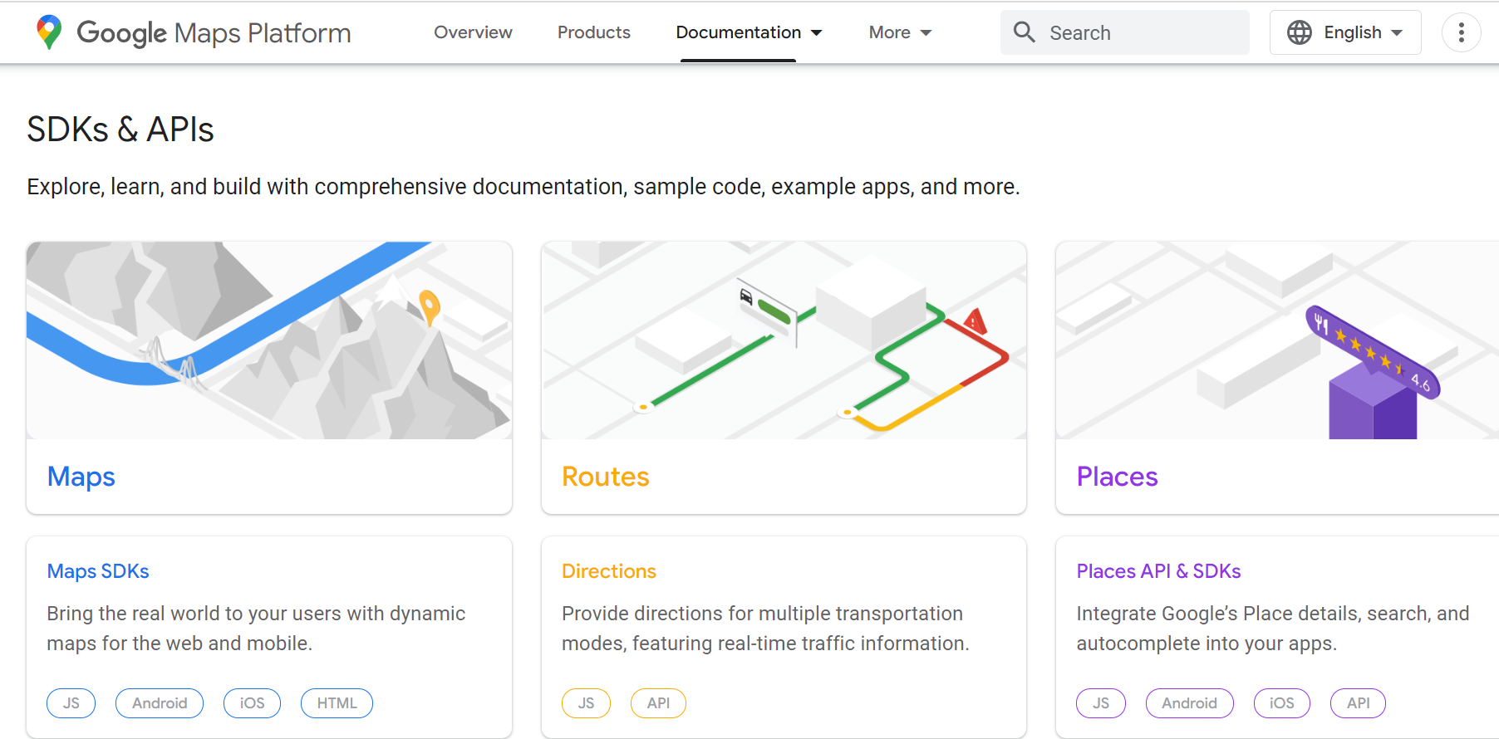
Web Services Use Cases – Maps Service
GoogleMaps API is used by the company to provide many kinds of data (location, navigation routes, landmark data). This helps global businesses integrate map data in their applications and provide services to their customers, suppliers, and delivery companies. Moreover, data offered by Google Maps is actively used by ridesharing applications like Uber

Slide 7
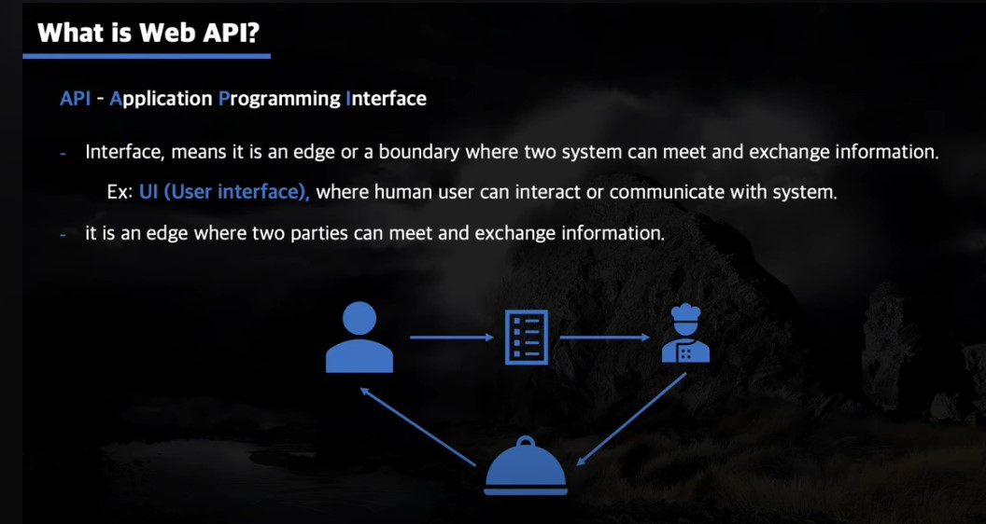

Slide 8
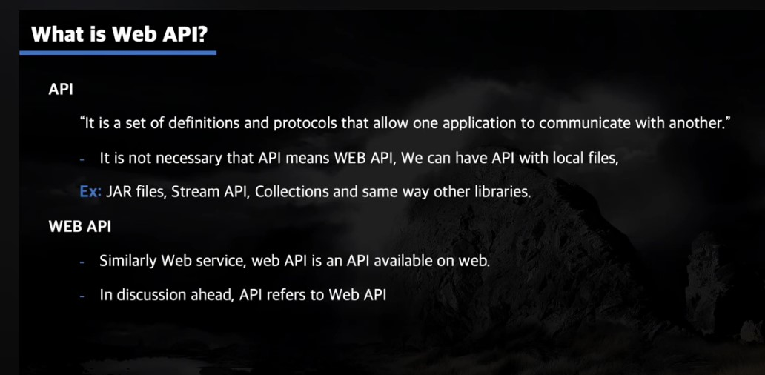

Slide 9
Web Service Vs. API
Application Programming Interface (API) is a set of software functions and procedures that enables data transmission between any kinds of software products. To put it simply, one can compare an API with a language used by two separate systems to communicate, but instead of verbal signals and symbols, there is a programming code that enables connection between devices.
API is a broader term than web service. It describes a communication layer between all types of systems, transmitting data both via web and offline channels. For instance, such APIs as DirectX or Vulkan are operating system interfaces that don’t use the web to exchange information.
A web service is an API that operates only via web communication. So, we can say that all web services are APIs; however not all APIs are necessarily web services. In this article, we may use both API and web service terms implying that we are talking about web-based APIs.

Slide 10
What is REST ?
The REST stands for REpresentational State Transfer.
State means data
REpresentational means formats (such as XML, JSON, YAML, HTML, etc)
Transfer means carrying data between consumer and provider using the HTTP protocol

Slide 11
What is REST API ?
REST an architectural style for building web services that interact via an HTTP protocol.
Its principles were formulated in 2000 by computer scientist Roy Fielding and gained popularity as a scalable and flexible alternative to older methods of machine-to-machine communication.
A web API that obeys the REST constraints is informally described as RESTful

Slide 12
What is REST API ?
A RESTful or REST API is an API that conforms to the design principles of the REST, or representational state transfer architectural style.
REST was originally coined by Roy Fielding, who was also the inventor of the HTTP protocol.
A web API that obeys the REST constraints is informally described as RESTful

Slide 13
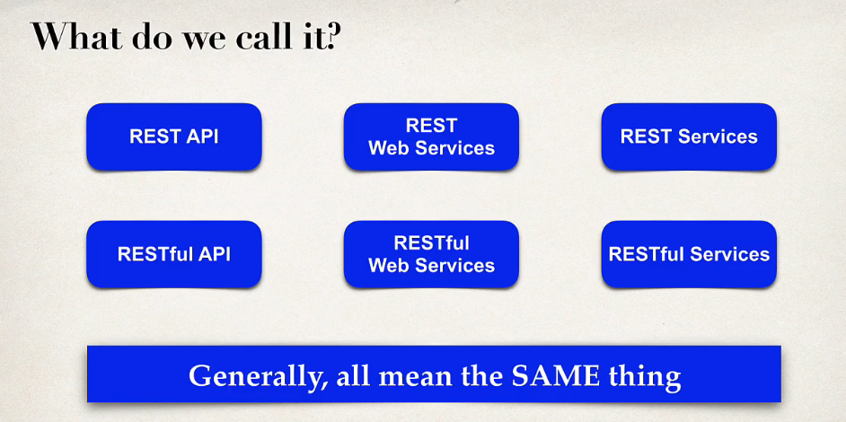

Slide 14
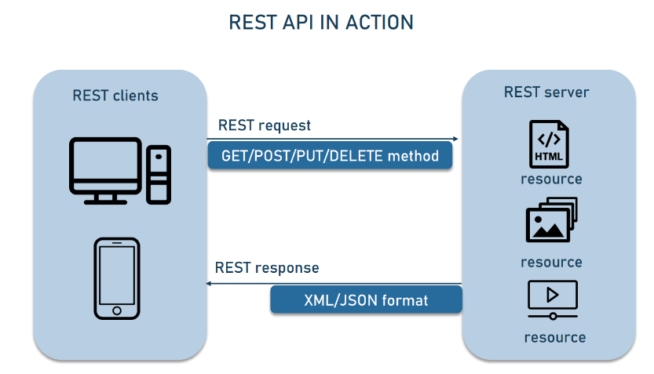
The key elements of the REST API paradigm are
a client or software that runs on a user’s computer or smartphone and initiates communication;
a server that offers an API as a means of access to its data or features; and
a resource, which is any piece of content that the server can provide to the client (for example, a video or a text file).

Slide 15
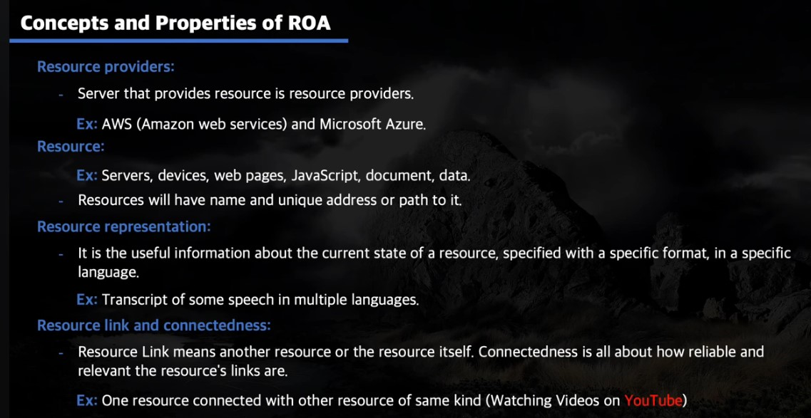

Slide 16
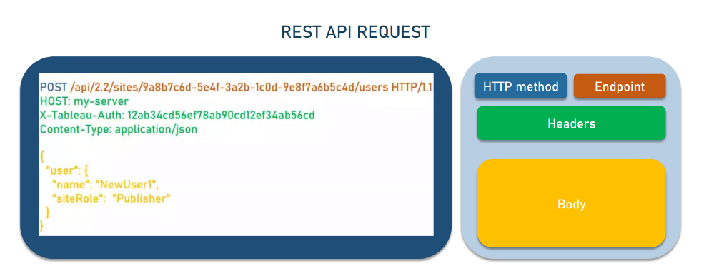

Slide 17
Any REST request includes four essential parts: an HTTP method, an endpoint, headers, and a body.
An HTTP method describes what is to be done with a resource. There are four basic methods also named CRUD operations:
POST to Create a resource, GET to Retrieve a resource,
PUT to Update a resource, and DELETE to Delete a resource.
An endpoint contains a Uniform Resource Identifier (URI) indicating where and how to find the resource on the Internet. The most common type of URI is a Unique Resource Location (URL), serving as a complete web address.
Headers store information relevant to both the client and server. Mainly, headers provide authentication data — such as an API key, the name or IP address of the computer where the server is installed, and the information about the response format.
A body is used to convey additional information to the server. For instance, it may be a piece of data you want to add or replace.

Slide 18
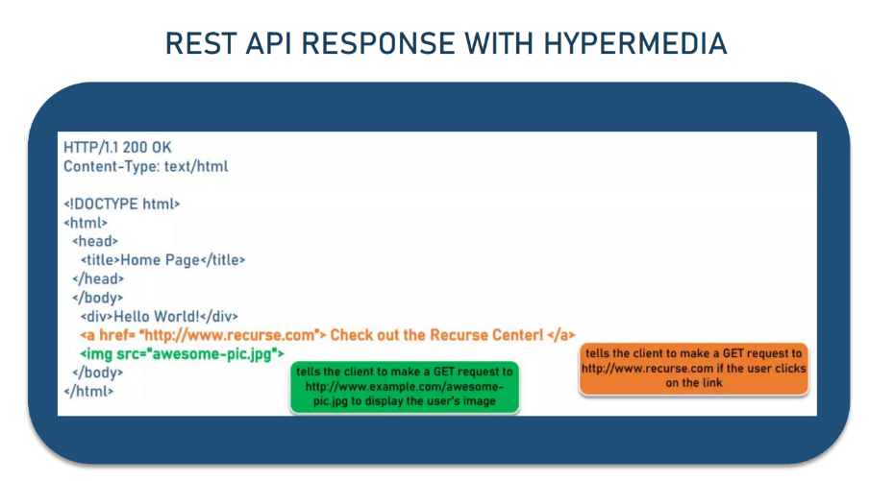

Slide 19
REST Principle – Client - Server
In REST API design, client and server applications must be completely independent of each other. The only information the client application should know is the URI of the requested resource; it can't interact with the server application in any other ways. Similarly, a server application shouldn't modify the client application other than passing it to the requested data via HTTP.
In the REST API system, the client and server work independently, using different tech stacks. The client doesn’t need to know anything about business logic, while the server has no idea about the user interface. The separation of responsibilities means that API providers and API consumers can be modified and it won’t backfire on their communication.

Slide 20
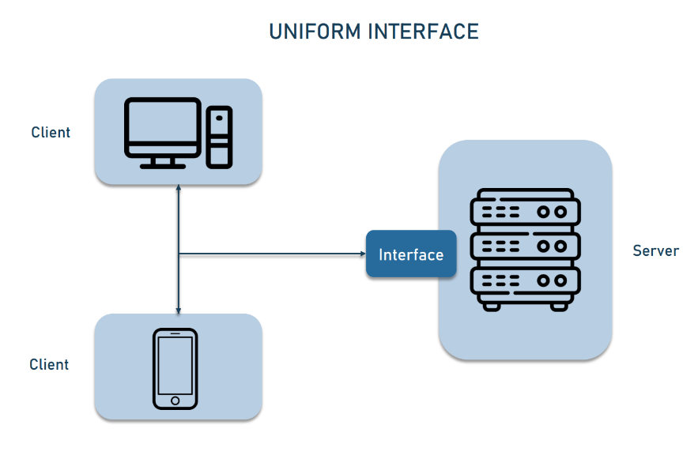
REST Principle – Uniform Interface
It is a key constraint that differentiate between a REST API and Non-REST API.
It suggests that there should be an uniform way of interacting with a given server irrespective of device or type of application (website, mobile app).

Slide 21
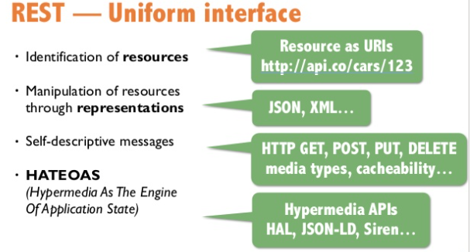

Slide 22
Identification of resources: Every system resource should be uniquely identifiable, by using a Uniform Resource Identifier (URI).
Manipulation of resources through representations: Clients should get a uniform representation of a resource that contains enough information to modify the resource's state in the server, as long as they have the required permissions.
Self-descriptive messages: Every resource representation should provide enough information for the client to know how to process it further, such as additional actions that can be performed on the resource.
Hypermedia as the engine of application state (HATEOAS): Clients should have enough information, in the form of hyperlinks, to dynamically discover other resources and drive other interactions.

Slide 23
REST Principle – Layered Architecture
The RESTful system has a layered structure in which each layer works independently and interacts only with the layers directly connected to it. When calling a server, a client doesn’t know whether there are any intermediaries along the way.
Due to the layered architecture, you can place a proxy or load balancer between the client and server and thus improve scalability.
Adding security as a separate layer enhances system safety. Although these services are involved in producing the response, the client doesn’t have to worry about what’s behind the interface.

Slide 24
REST Principle – Statelessness
Systems aligning with the REST paradigm are bound to become stateless.
For Client-Server communication, stateless constraint enforces servers to remain unaware of the client state and vice-versa.
A constraint is applied by using resources instead of commands, and they are nouns of the web that describe any object, document, or thing to store/send to other resources.

Slide 25
REST Principle – Cacheable
Cache helps servers to mitigate some constraints of statelessness.
It is a critical factor that has improved the performance of modern web applications.
Caching not only enhances the performance on the client-side but also scales significant results on the server-side.
A well-established cache mechanism would drastically reduce the average response time of your server

Slide 26
REST Principle – Code on Demand
Of all the constraints, this one is optional. The usual format used while sending resources is JSON REST API or XML. But whenever it is required, you are provided with an option to return executable code. This will support the main part of your application.

Slide 27
REST Principle – Summary
REST APIs are designed around resources, which are any kind of object, data, or service that can be accessed by the client.
A resource has an identifier, which is a URI that uniquely identifies that resource. For example, the URI for a particular customer order might be:
https://adventure-works.com/orders/1
Clients interact with a service by exchanging representations of resources. Many web APIs use JSON as the exchange format. For example, a GET request to the URI listed above might return this response body:
{"orderId":1,"orderValue":99.90,"productId":1,"quantity":1}

Slide 28
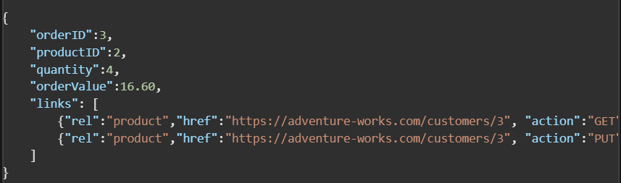
REST Principle – Summary
REST APIs use a uniform interface, which helps to decouple the client and service implementations. For REST APIs built on HTTP, the uniform interface includes using standard HTTP verbs to perform operations on resources. The most common operations are GET, POST, PUT, PATCH, and DELETE.
REST APIs are driven by hypermedia links that are contained in the representation. For example, the following shows a JSON representation of an order.

Slide 29
REST – KEY TERMS
Request and Response: Request is the input to a web service, and the response is the output from a web service.
Message Exchange Format: It is the format of the request and response. There are two popular message exchange formats: XML and JSON.
Service Provider or Server: The service provider is one that hosts the web service.
Service Consumer or Client: A service consumer is one who is using a web service.
The fundamental concept of a REST-based system is the resource. A resource is anything you want to expose to the outside world, through your application.
It is the responsibility of the consumer means client application to prepare and send HTTP request message It is the responsibility of the business component (developed by a service provider) to prepare and send the HTTP response message

Slide 30
Websites for Practice
https://reqres.in/
https://dummyjson.com/
https://gorest.co.in/
https://jsonpathfinder.com/
https://jsonschema.net/

Slide 31
Define API Operations Using http Methods
GET retrieves a representation of the resource at the specified URI. The body of the response message contains the details of the requested resource.
POST creates a new resource at the specified URI. The body of the request message provides the details of the new resource. Note that POST can also be used to trigger operations that don't actually create resources.
PUT either creates or replaces the resource at the specified URI. The body of the request message specifies the resource to be created or updated.
PATCH performs a partial update of a resource. The request body specifies the set of changes to apply to the resource.
DELETE removes the resource at the specified URI.

Slide 32
REST API Best Practices
1. REST API MUST ACCEPT AND RESPOND WITH JSON
2. GO WITH ERROR STATUS CODES
3. DON’T USE VERBS IN URLS
4. USE PLURAL NOUNS TO NAME A COLLECTION
5. WELL COMPILED DOCUMENTATION
6. RETURN ERROR DETAILS IN THE RESPONSE BODY

Slide 33
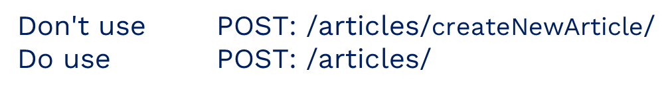
REST API Best Practices: Prioritize Nouns over Verbs in URI
REST Verb | Action
GET | Fetches a record or set of resources from the server
OPTIONS | Fetches all available REST operations
POST | Creates a new set of resources or a resource
PUT | Updates or replaces the given record
PATCH | Modifies the given record
DELETE | Deletes the given resource
GET/books/123
DELETE/ books/123
POST/books
PUT/books/123
PATCH/book/123

Slide 34

REST API Best Practices
Prefer Using plural naming conventions

Slide 35
REST API Best Practices
Use resource nesting efficiently
/users // list all users
/users/123 // specific user
/users/123/orders //list of orders that belong to a specific user
/users/123/orders/0001 // specific orders of a specific users order list

Slide 36
REST API Best Practices
Use systematic documentation
The utilization of framework, application, or software usage requires proper documentation.
This document will act as a reference while troubleshooting an issue.
This API documentation needs to be precise and simple enough for non-technical people to understand it.
Doing such systematic documentation will help your users indulge and understand all the necessary aspects like error handling, security, and authentication.

Slide 37
REST API Best Practices
Use data filtering options
Filtering
GET /users?country=UK
GET /users?creation_date=2021-10-11
GET /users?creation_date=2021-10-11
Sorting
GET /users?sort=birthdate_date:asc
GET /users?sort=birthdate_date:desc
Paging
GET /users?limit=120
GET /users?offset=3

Slide 38
REST API Best Practices
Focus on error handling
The HTTP error code will point to the nature of the individual error when the API is effective. REST API has 71 unique errors with HTTP status codes with error messages. Along with the standard error handling of HTTP statuses, and elaborated message on the internal code will help the user to understand better.
Idel error handling code consists of 3 parts:
Error – a unique identifier of the error
Message – a comprehensive, readable message
Detail – lengthier explanation of the message
For example, when you receive a login response with an incorrect password, you can send a 401 response with a code like this,
{ "error": "auth-0001", "message": "Incorrect username and password", "detail": "Ensure that the username and password included in the request are correct" }

Slide 39
REST API Best Practices
Use SSL/TLS Security layers
One of the REST API Best practices is to encrypt the communication using SSL/TLS.
It is very essential to ensure database security for any API developer. The earned trust of the customers to keep their sensitive details private is a must.
To avoid security breaches, you need to use SSL (Secure Socket Layer) and TLS (Transport Layer Security).
SSL/TSL provides a public and private key to give a secured connection.
TSL is an advanced version of SSL and hence provides better protection and security.

Slide 40
URI – Uniform Resource Identifier
The resource can be identified by a Uniform Resource Identifier (URI). For web-based systems, HTTP is the most commonly used protocol for communicating with external systems. You can identify a unique resource using a URI.
Consider, we are developing a simple blog application and you can define URIs for a blog Post resource:
GET—http://localhost:8080/api/posts/: Returns a list of all posts
GET—http://localhost:8080/api/posts/2: Returns a post whose ID is 2
POST—http://localhost:8080/api/posts/: Creates a new Post resource
PUT—http://localhost:8080/api/posts/2: Updates a POST resource whose ID is 2
DELETE—http://localhost:8080/api/posts/2: Deletes a POST resource whose ID is 2

Slide 41
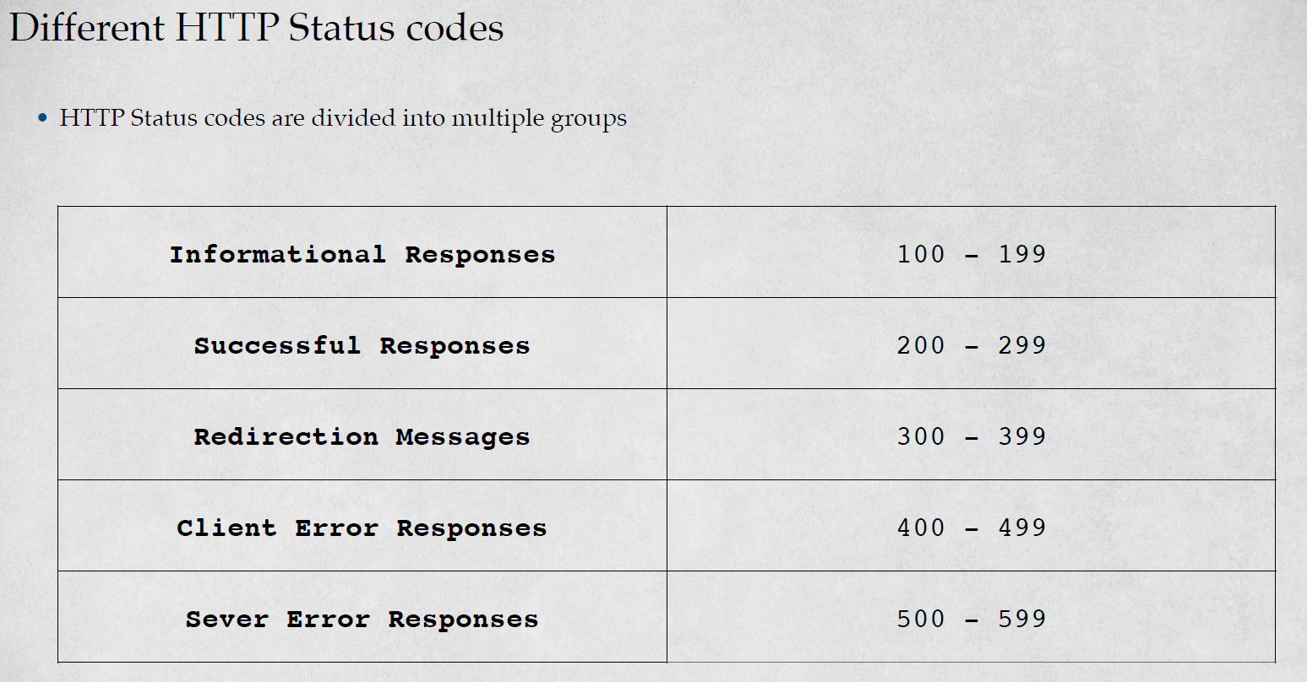

Slide 42
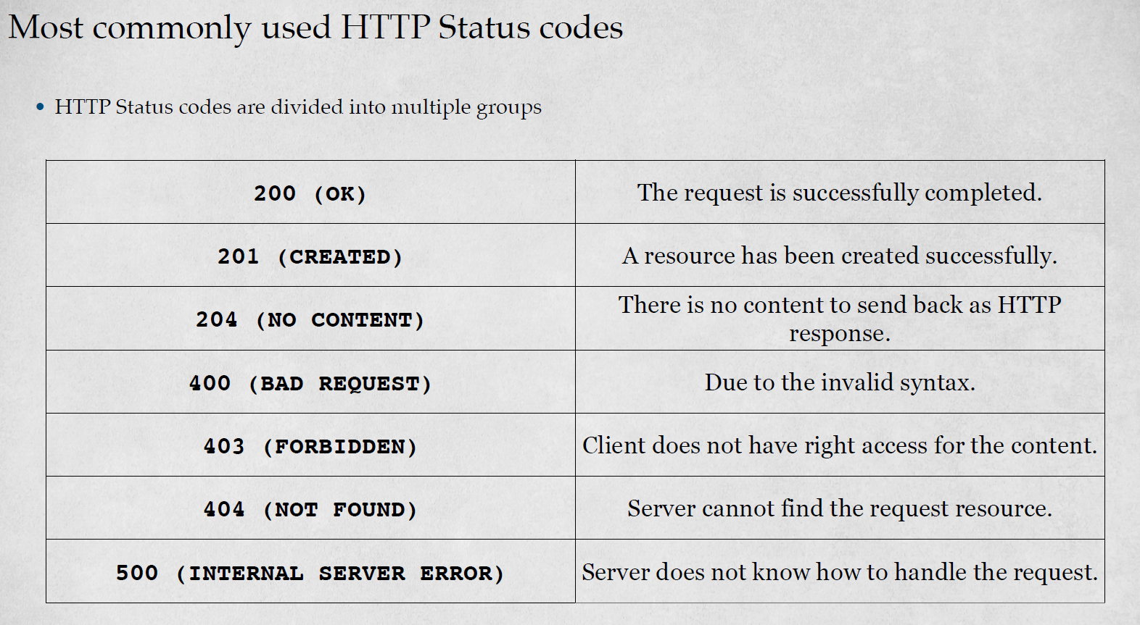

Slide 43
Spring Boot Annotations
@RestController is the central artifact in the entire Web Tier of the RESTful API. It is a specialized version of the controller. It includes the @Controller and @ResponseBody annotations, and as a result, simplifies the controller implementation.
If you use @RestController, then no need to use @ResponseBody also.
@ResponseBody maps a Java object to the HttpRequest body. Simply, convert the Java object to the JSON object and passed back into the HttpResponse object.
@RequestBody maps the HttpRequest body onto a Java object. Simply, convert JSON object to Java object.
@ResponseStatus is used for setting HTTP response codes

Slide 44
Spring Boot Annotations
@RequestMapping is used for mapping web requests onto methods. Furthermore, spring simplifies this for us when we use method levels.
@PostMapping => @RequestMapping(method = RequestMethod.POST)
@GetMapping => @RequestMapping(method = RequestMethod.GET)
@PutMapping => @RequestMapping(method = RequestMethod.PUT)
@DeleteMapping => @RequestMapping(method = RequestMethod.DELETE)
@PatchMapping => @RequestMapping(method = RequestMethod.PATCH)
@PathVariable is used for extracting the value from the URI.
@RequestParam is used for extracting query parameters from the request.

Slide 45
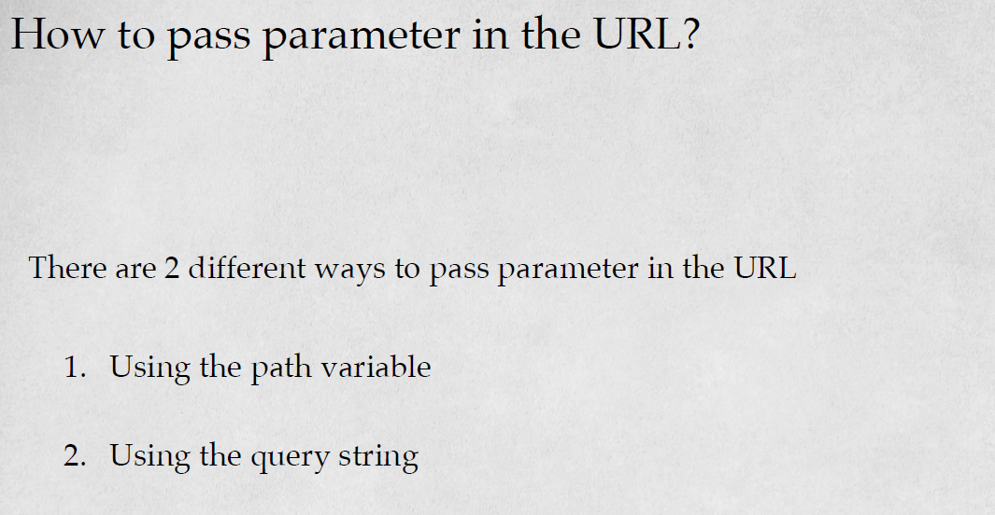

Slide 46
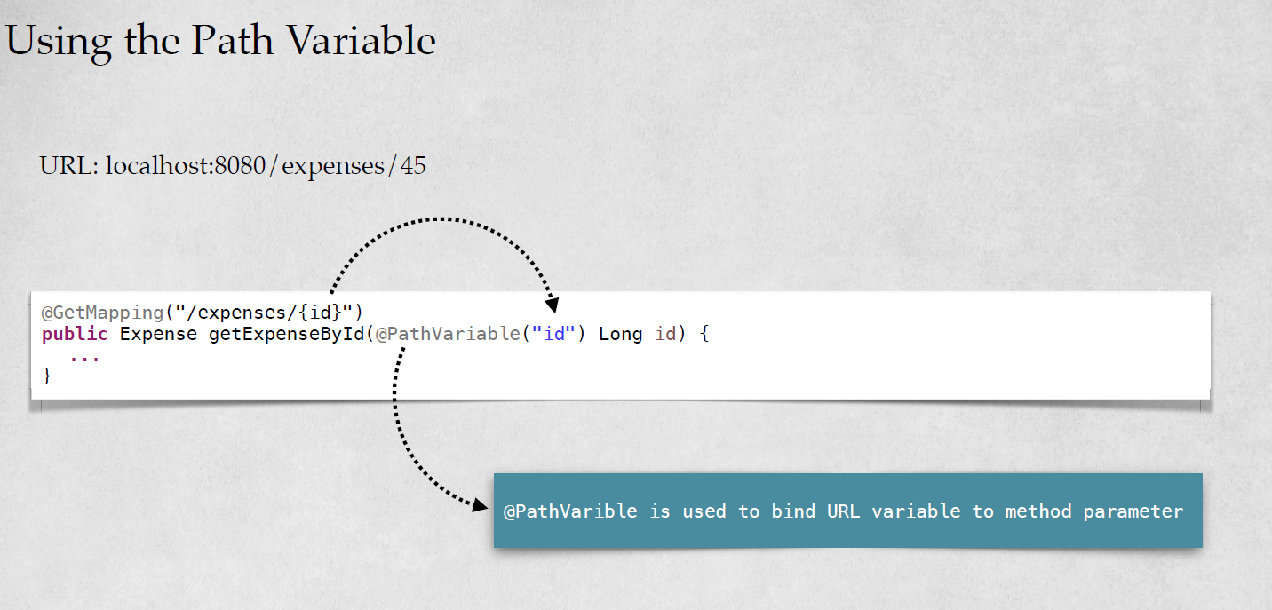

Slide 47
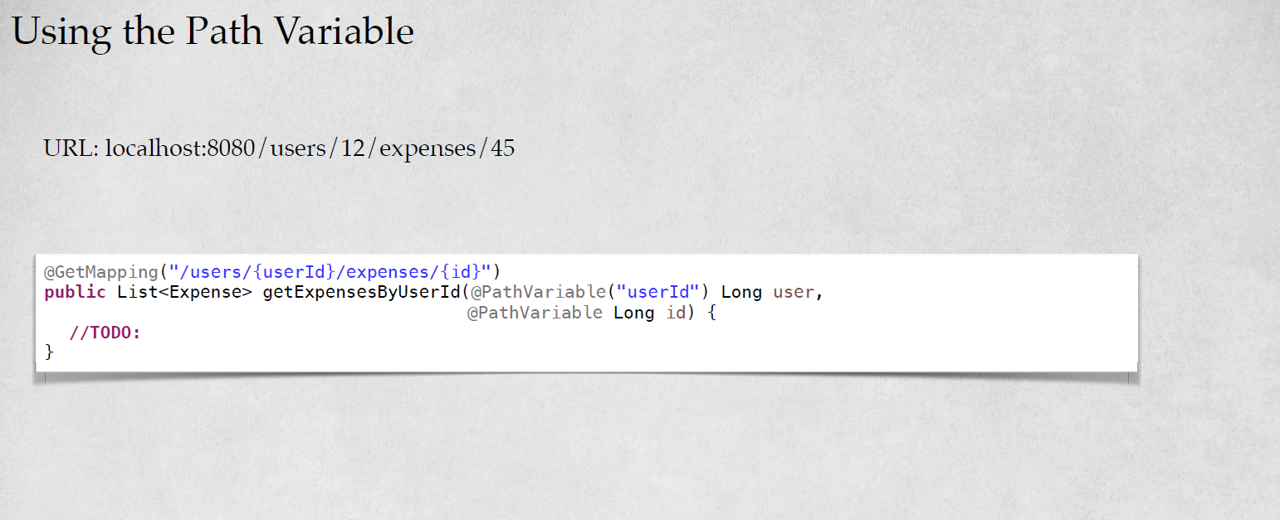

Slide 48
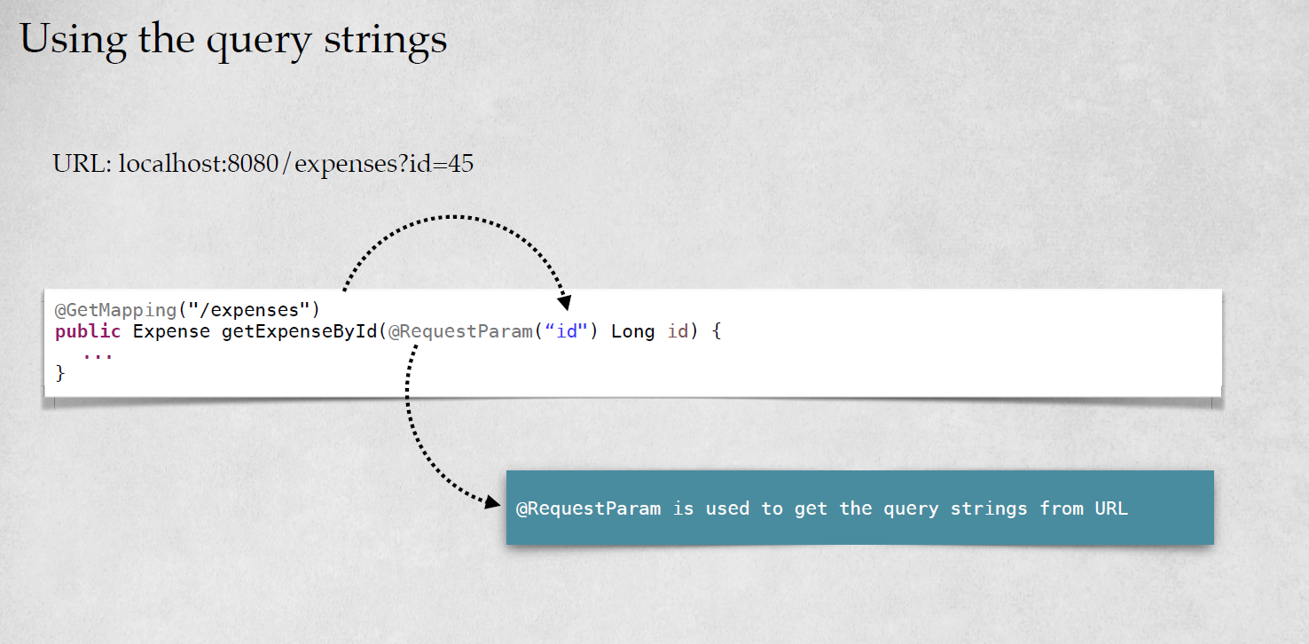

Slide 50
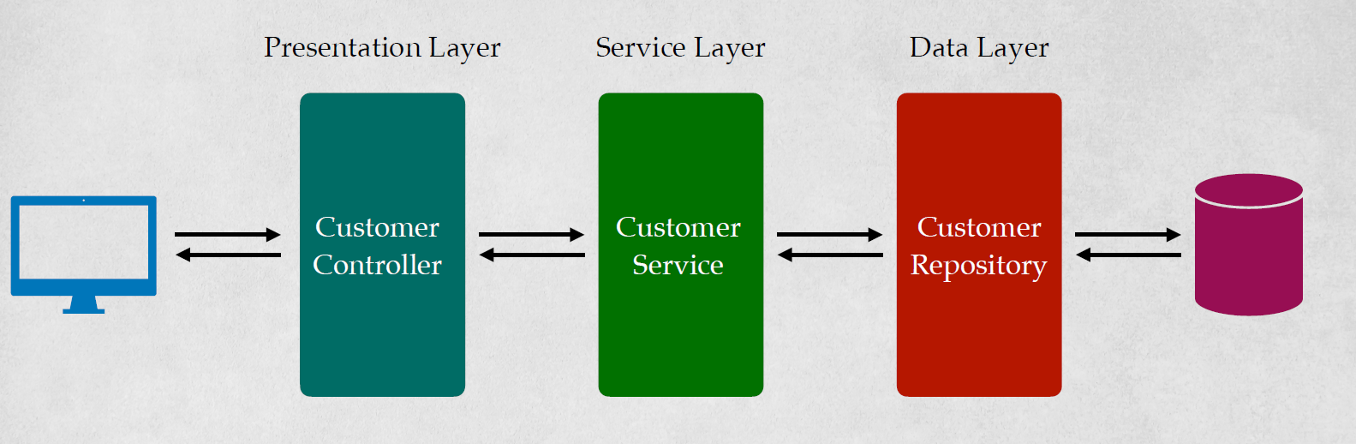
Spring Boot REST Application Architecture

Slide 51
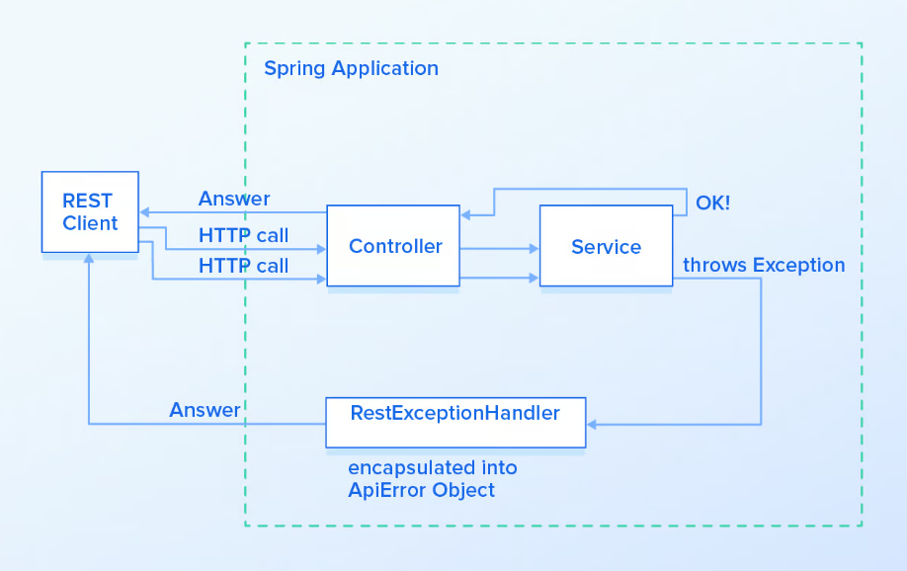
Handling Exceptions

Slide 52
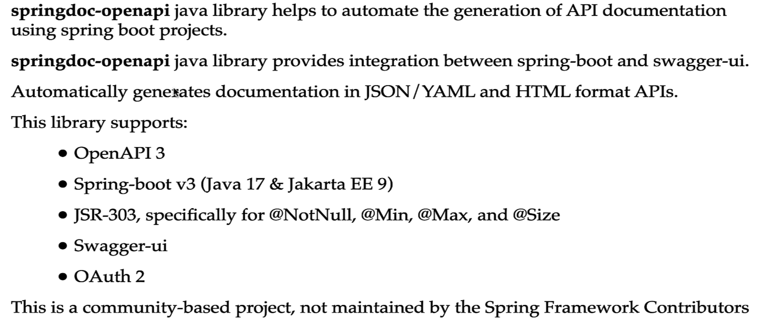
Documentation

Slide 53
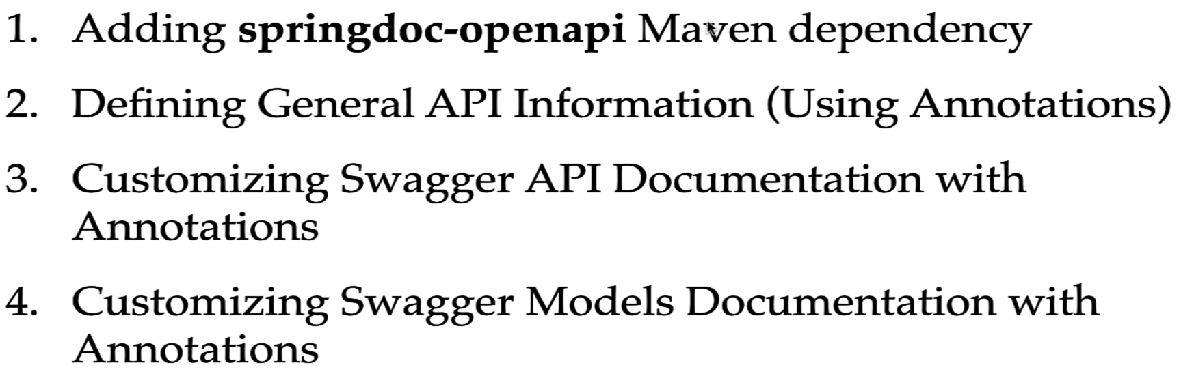
Development Steps
@Operation( summary = "Create Post REST API", description = "Create Post REST API is used to save post into database" ) @ApiResponse( responseCode = "201", description = "Http Status 201 CREATED" ) @SecurityRequirement( name = "Bear Authentication" )
@Tag( name = "CRUD REST APIs for Post Resource" )

Slide 54
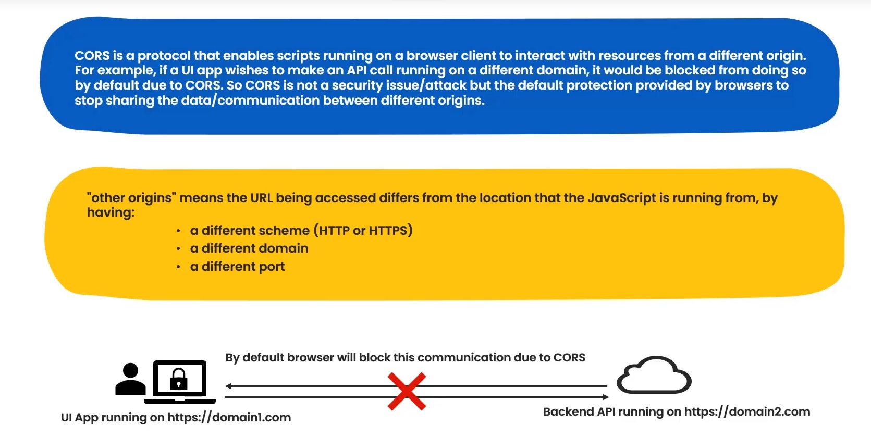
Cross Origin

Slide 55
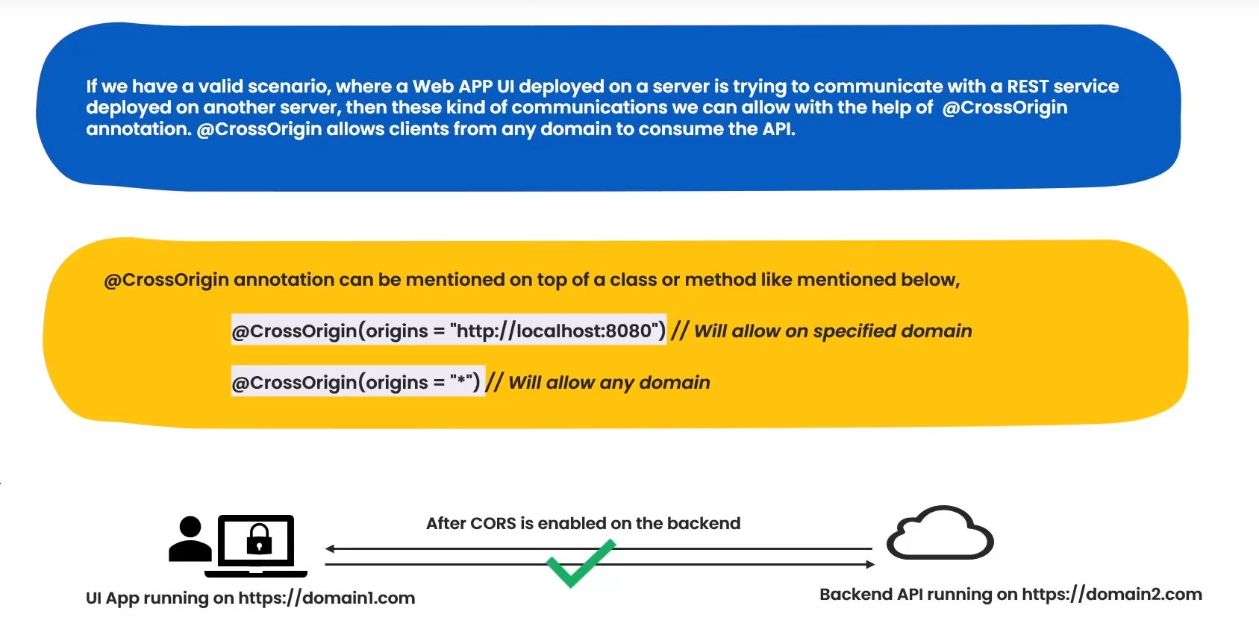
Cross Origin

Slide 56
Assignment
Methods | Urls | Actions
POST | /api/tutorials | create new Tutorial
GET | /api/tutorials | retrieve all Tutorials
GET | /api/tutorials/:id | retrieve a Tutorial by :id
PUT | /api/tutorials/:id | update a Tutorial by :id
DELETE | /api/tutorials/:id | delete a Tutorial by :id
DELETE | /api/tutorials | delete all Tutorials
GET | /api/tutorials/published | find all published Tutorials
GET | /api/tutorials?title=[keyword] | find all Tutorials which title contains keyword

